Slide 1
INDUSTRIAL PUMP
MAINTENANCE ANALYSIS
Fleet-Level Performance & Predictive Insights

Slide 2
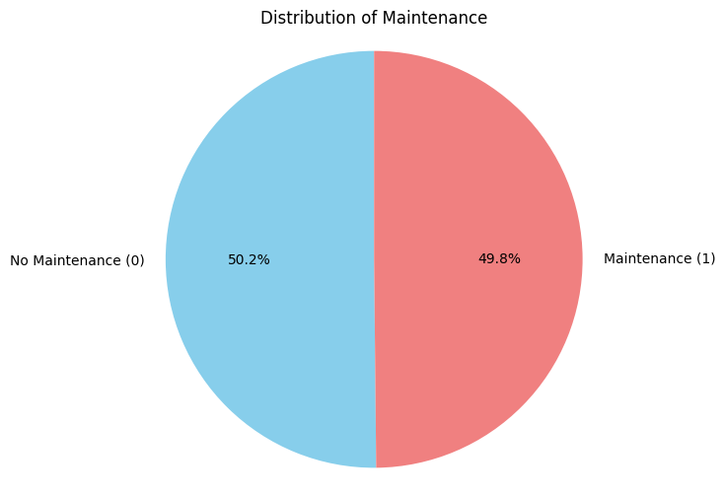
EXECUTIVE SUMMARY
20,000
5
<2%
49.84%
Records
Variation
Maint Rate
Pumps

Slide 3
DATASET OVERVIEW AND QUALITY
✓ 20,000 observations across 5 pumps
✓ 6 operational sensors (Temp, Vibration, Pressure, Flow, RPM, Hours)
✓ Perfectly balanced: 50.16% no maintenance, 49.84% requires maintenance.
✓ Zero missing values - pristine data quality
✓ Maintenance rates: 48.6% - 50.6% (consistent)
KEY INSIGHT:
Fleet operates identically with <2% variation between pumps

Slide 4
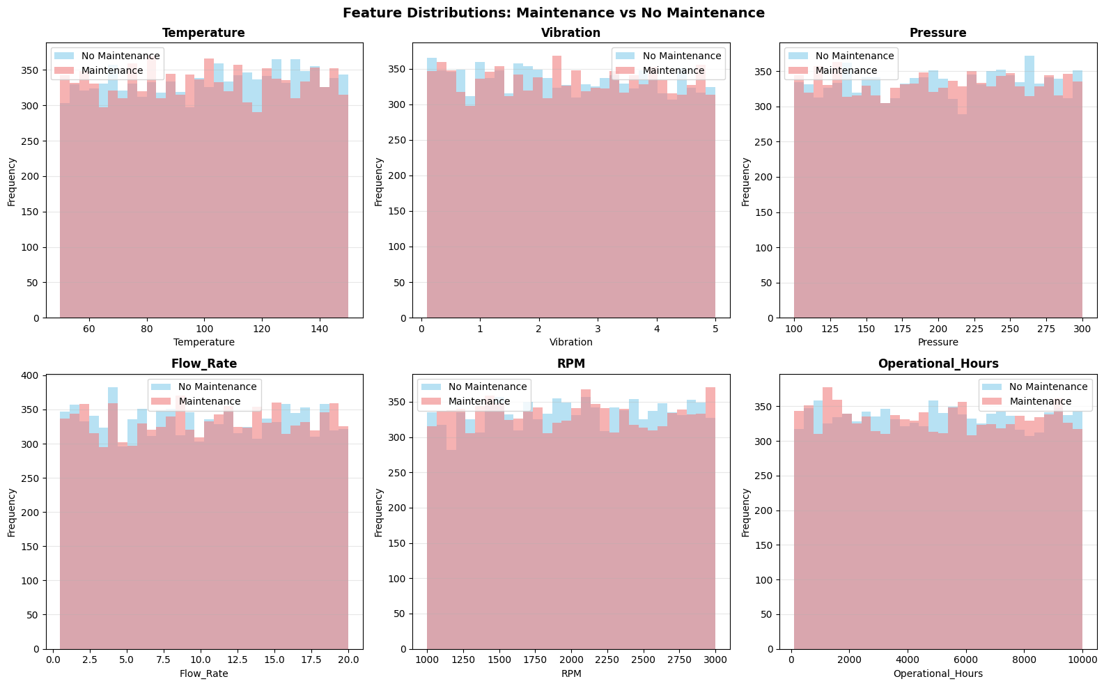
STATISTICAL SIGNIFICANCE TESTING
Distributions are IDENTICAL - no separation between groups (proves independence)

Slide 5
STATISTICAL SIGNIFICANCE TESTING
Comparing sensor readings between maintenance groups:
FEATURE CORRELATION P-VALUE
Temperature -0.0131 0.0649
Vibration +0.0076 0.2841
Pressure -0.0052 0.4653
Flowrate +0.0087 0.2200
RPM -0.0086 0.2258
Operational Hours -0.0031 0.6613
KEY FINDING:
All p-values > 0.05 (NOT significant)
All correlations < 0.015 (negligible)
Sensor readings are INDEPENDENT of maintenance

Slide 6
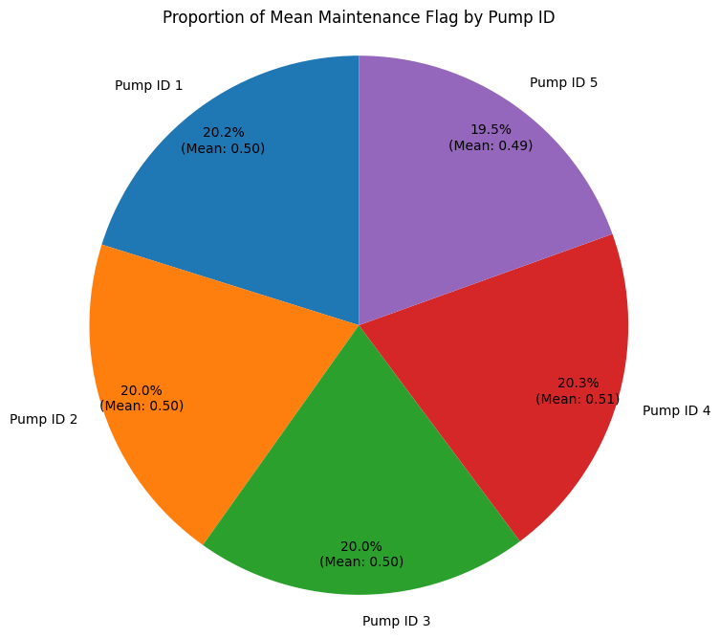
MAINTENANCE FLAG

Slide 7
FLEET PERFORMANCE RANKING
Pump 5
48.61%
BEST
Pump 2
49.87%
Good
Pump 3
49.91%
Good
Pump 1
50.24%
Fair
Pump 4
50.57%
HIGH

Slide 8
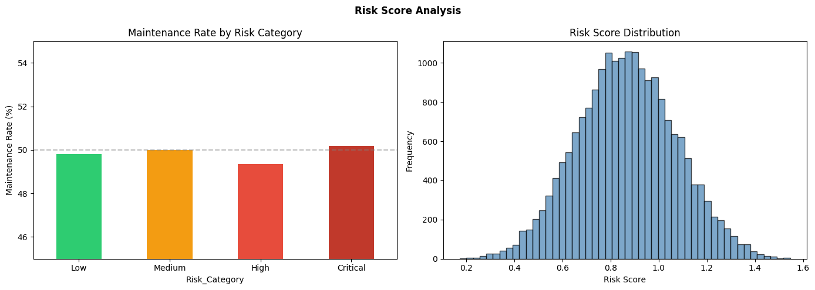
RISK SCORE ANALYSIS
Risk categories all ~50% (zero discriminative power)

Slide 9
RISK SCORE ANALYSIS
Risk score combines all 6 features with weights:
Vibration 20%, Hours 20%, Others 15% each
MAINTENANCE RATE BY RISK CATEGORY:
Low Risk (0.17-0.73) → 49.80%
Medium Risk (0.73-0.87) → 50.00%
High Risk (0.87-1.01) → 49.36%
Critical Risk (1.01-1.55) → 50.20%
EXPECTED vs ACTUAL:
Expected: Low 20%, Critical 80%
Actual: All ~50% (IDENTICAL!)
Risk score has ZERO discriminative power!
Even a perfect feature combination fails.

Slide 10
LIFECYCLE ANALYSIS
Maintenance Rate by Operational Hours:
LIFECYCLE STAGE HOURS MAINTENANCE %
Early Stage <2.5k hrs 50.55%
Growth Phase 2.5-5k hrs 49.28%
Mature Phase 5-7.5k hrs 49.18%
Late Stage >7.5k hrs 50.37%
EXPECTED: Bathtub curve (new: 20%, middle: 10%, old: 70%)
ACTUAL: Flat line at ~50% across all ages
NO degradation with age
Contradicts normal industrial failure patterns
Suggests synthetic or externally scheduled data

Slide 11
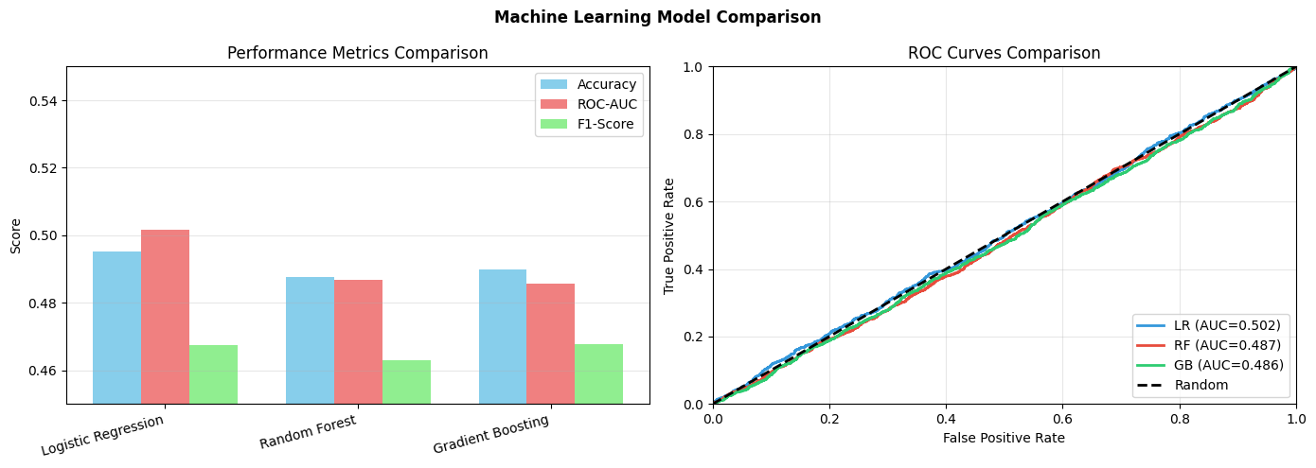
MACHINE LEARNING MODEL COMPARISON
All models ~50% baseline, ROC curves overlap with random

Slide 12
MACHINE LEARNING MODEL COMPARISON
TESTED 3 DIFFERENT ALGORITHMS:
Model Accuracy ROC-AUC F1-Score
Logistic Regression 49.53% 0.5016 0.4674
Random Forest 48.75% 0.4868 0.4631
Gradient Boosting 49.00% 0.4857 0.4676
Random Guessing 50.00% 0.5000 0.5000 ← Baseline
CROSS-VALIDATION:
• Logistic Regression: 0.5089 ± 0.0055
• Random Forest: 0.5003 ± 0.0126
• Gradient Boosting: 0.5050 ± 0.0029
All 3 different algorithms perform at RANDOM BASELINE
The problem is DATA, not MODEL SELECTION

Slide 13
FEATURE IMPORTANCE ANALYSIS
RANDOM FOREST:
RPM 17.09% | Flow 16.71% | Pressure 16.58% | Hours 16.58%
Temp 16.53% | Vibration 16.52%
→ All within 1% (PERFECT UNIFORMITY)
GRADIENT BOOSTING:
Hours 17.23% | Vibration 17.07% | Flow 16.87% | RPM 16.54%
Pressure 16.23% | Temperature 16.05%
→ All within 1% (PERFECT UNIFORMITY)
NORMAL PATTERN (Real Data):
Top: 35-50% | Middle: 15-25% | Weak: 5-10% → Clear hierarchy
THIS DATA PATTERN:
All: 16-17% → Perfect uniformity
No feature is more important than the others
Uniform distribution = all equally useless

Slide 14
POSSIBLE EXPLANATIONS
Synthetic Data(Most Likely)
Perfect 50/50, Educational use
External Schedule (TIME-BASED)
Calendar maintenance, not condition-based
Failure-Driven (EVENT-BASED)
Unpredictable failures, reactive maintenance

Slide 15
NEXT STEPS AND RECOMMENDATIONS
IMMEDIATE ACTIONS
1. DATA VERIFICATION
✓ Confirm if synthetic or real
✓ Clarify maintenance logic
✓ Identify external factors
2. IF REAL DATA - COLLECT MORE
✓ Bearing temperature
✓ Vibration frequency spectrum
✓ Oil analysis metrics
✓ Actual failure timestamps
3. ALTERNATIVE APPROACHES
✓ Anomaly detection
✓ Time-series modelling (LSTM)
✓ Failure prediction
✓ Cost-based optimisation
4. FLEET OPTIMIZATION
✓ Monitor Pump 4 (highest maintenance)
✓ Benchmark Pump 5 (best performer)
✓ TCO analysis

Slide 16
CRITICAL FINDINGS SUMMARY
CONVERGENCE OF EVIDENCE:
STATISTICAL:
Correlations < 0.015 (zero relationship)
P-values > 0.05 (not significant)
ENGINEERING:
Risk score: ~50% (no discrimination)
Lifecycle: No degradation
Fleet: <2% variation
MACHINE LEARNING:
All models: ~50% accuracy (random)
Feature importance: Uniform
FINAL VERDICT:
Maintenance is INDEPENDENT of sensors
This is a DATA problem, not a MODEL problem

